Slide 1

Black Friday Dataset Cleaning Project Improve data quality and promote accurate analysis
Yongshu Cui
Peng Zhao
Xiaolin Liu
Ting Yang
2023/11/22

Slide 2


Introduction
Introduction
Black Friday is the beginning of the Christmas shopping season in the United States. Major retailers like Amazon and Costco offer discounts and deals on various products to attract customers. We selected the Black Friday dataset as the data source for our curation project. This dataset provides interesting insights into customer behavior during shopping holidays.
Purpose
In this project, we focus on a key task: improving the quality of the Black Friday dataset. Through precise cleaning and processing of these data, a more accurate and reliable data foundation is provided. To predict customer spending during Black Friday sales. These predictions can help retailers understand and tailor their products to meet customer preferences.

Slide 3
Dataset Schema
Sample Data
Here is the data schema of the Black Friday dataset
*Data source: https://drive.google.com/file/d/1kS25NE46YLJE2GH4yPFaYRP_PxzLngu-/view?pli=1

Slide 4
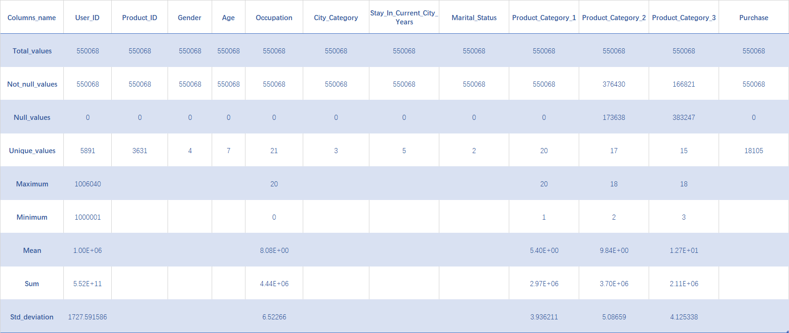
Dataset Overview
There are 12 columns and 550068 rows in total，as shown above.

Slide 5
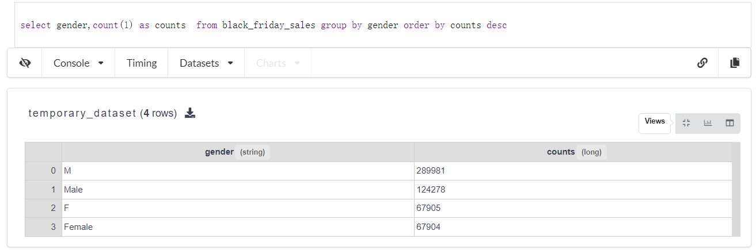
Issues Discovery
Data Inconsistency
Check the distinct values for each column, we find the values in Gender are not consistent, since there are "M" and "Male" for male, "F" and "Female" for female. It might lead to incorrect market targeting, inaccurate user profiling, and decisions based on unreliable gender-related strategies.

Slide 6
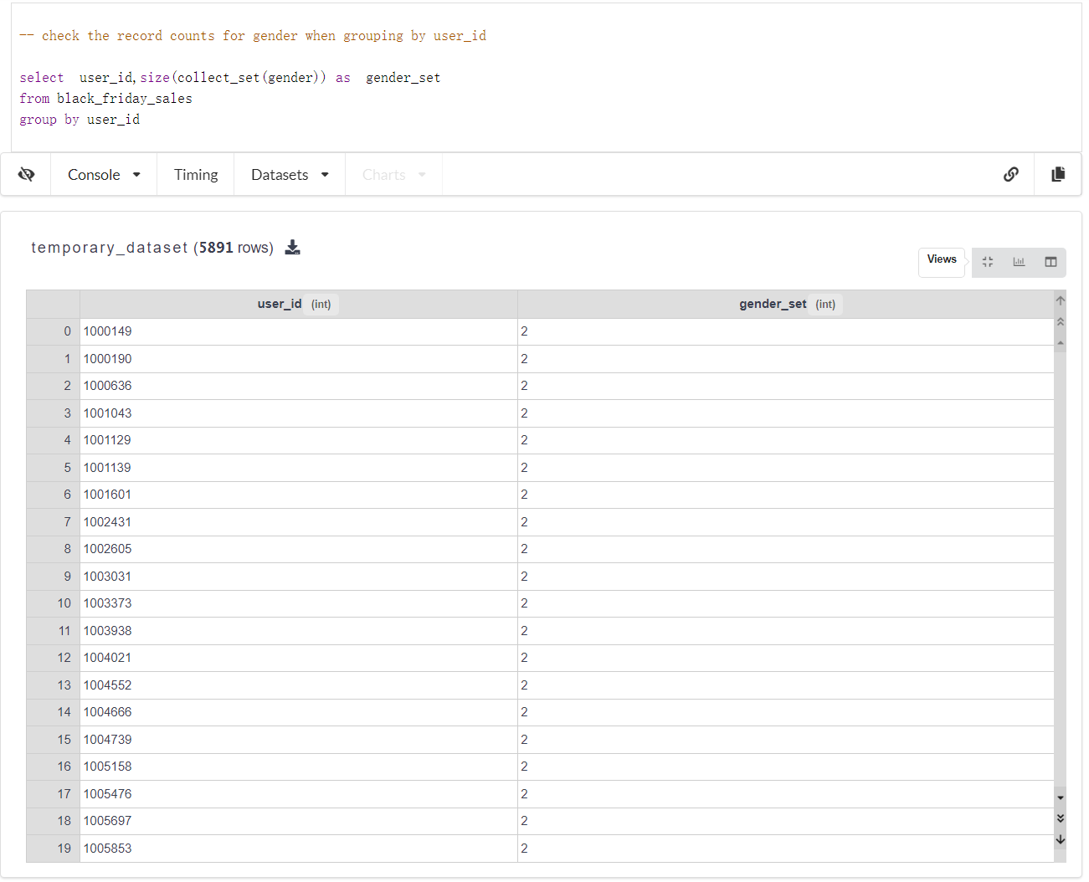
Issues Discovery
Inconsistent
Representations
Group by the userid and count the number of genders, we find that there are 2 genders for one user, which is unreasonable.

Slide 7
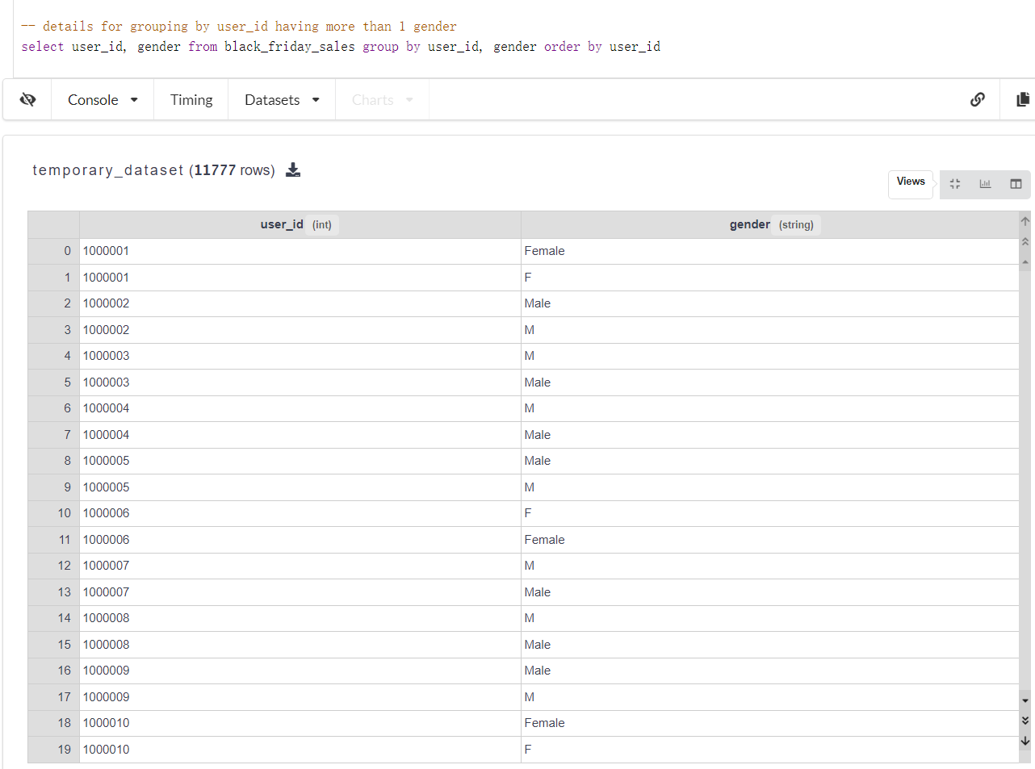
Issues Discovery
Inconsistent Representations
In the beginning, we thought it was a functional dependency issue, but looking into the details, we found the genders are the same, just used different represents. The solution will provide the analysis result.

Slide 8
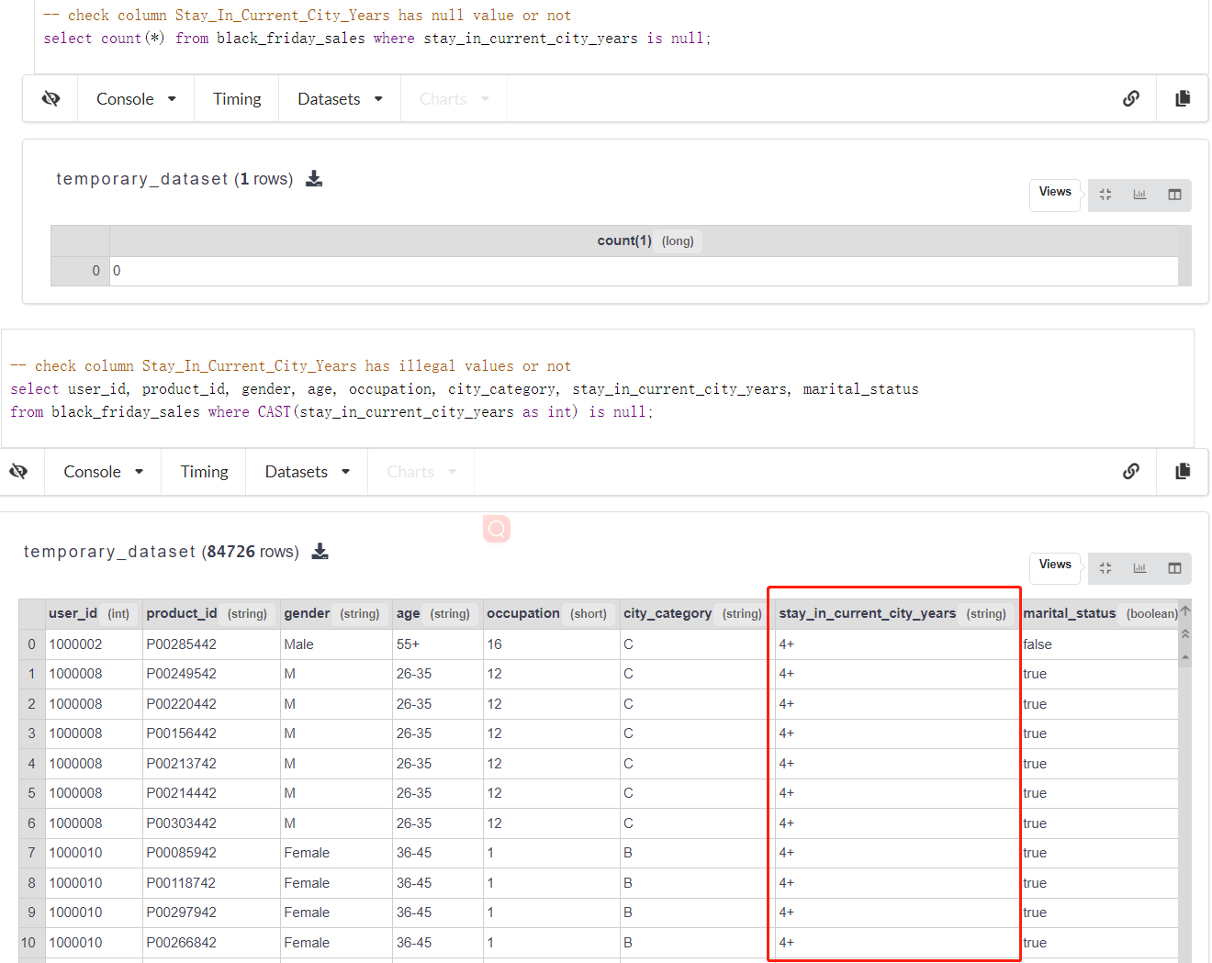
Data Quality Issue for Incorrect Values
When checking column Stay_In_Current_City_Years, there is no NULL value, but we find there are a lot of values that are mistyped with short, for example result as below table.

Slide 9
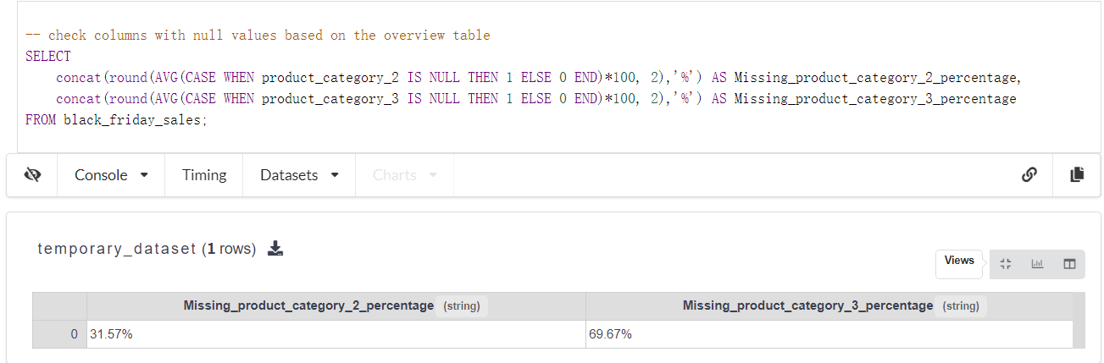
Data Quality Issue for NULL Values
Based on the overview table, there are 2 columns with null values: Product_Category_2 and Product_Category_3
Calculating the missing rate for these two columns in the table,
According to the result, we'll use different solutions for these 2 columns in Solutions.

Slide 10
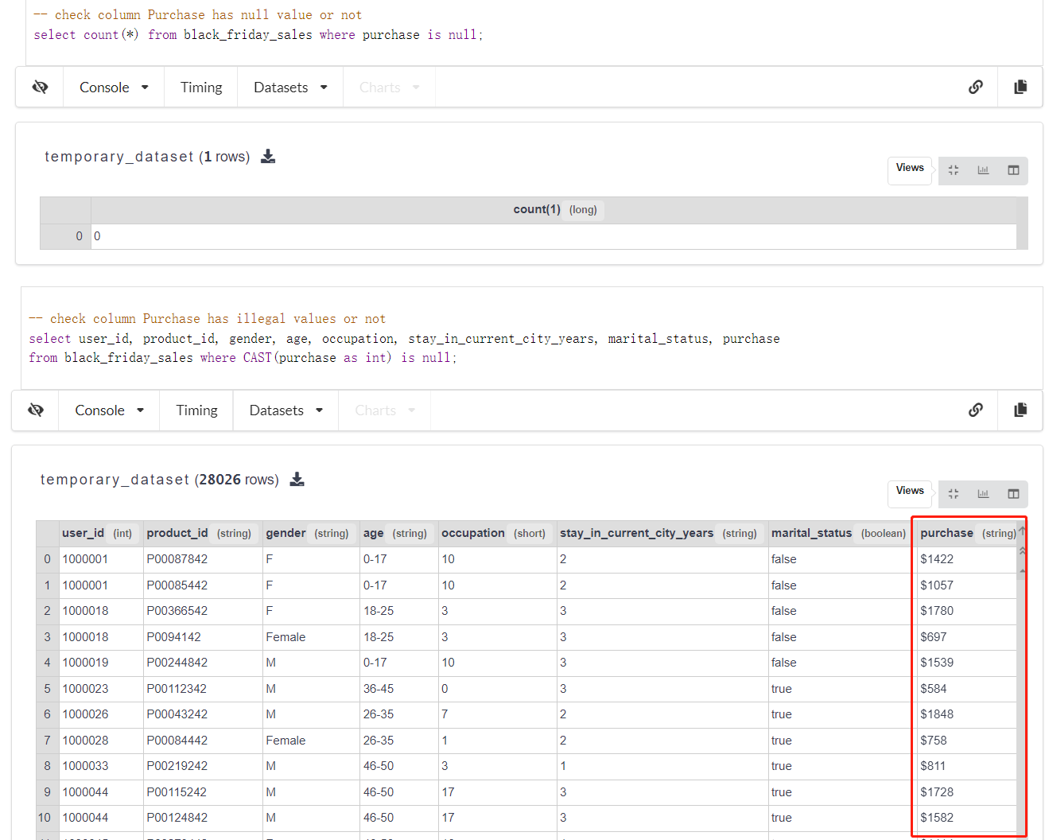
Data Quality Issue for Incorrect Values - Purchase
Similar to column Stay_In_Current_City_Years, there is no NULL value in column Purchase, and we also find there are values that are mistyped with short, for example result as figure show.

Slide 11
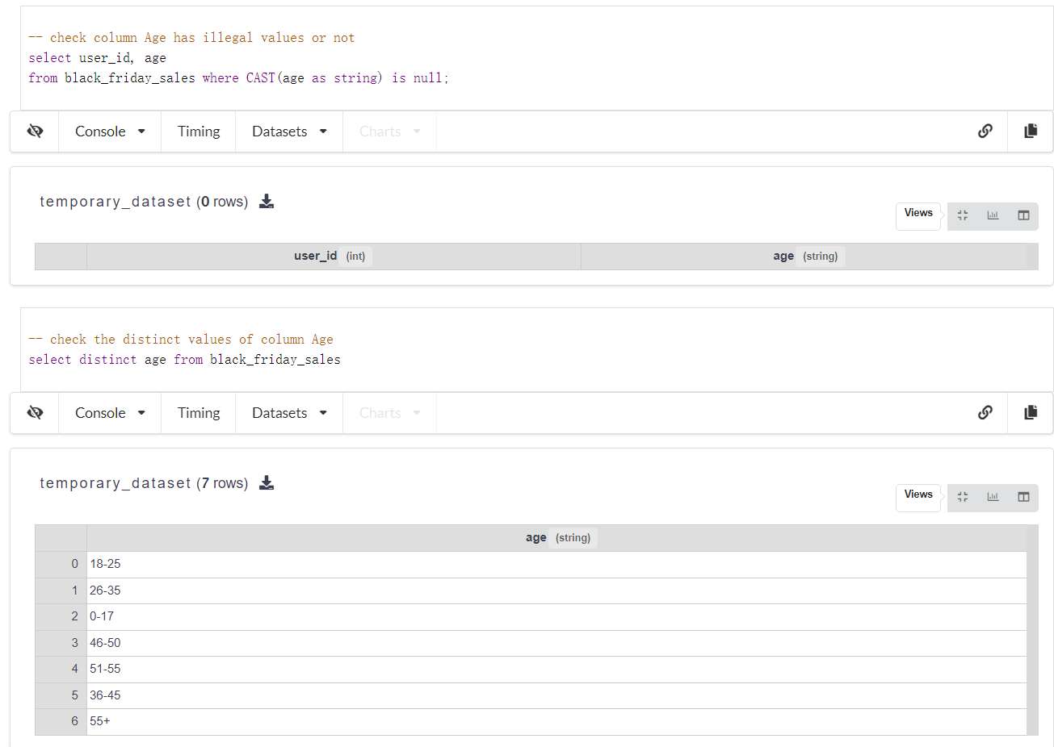
Data Field Normalization
Based on the overview table, we know that the column Age does not have a NULL value, so it appears that there is nothing wrong with that column that needs to be fixed. But when looking at the detailed data, we see that the raw data uses ranges to represent the user's age, as shown on the right.

Slide 12
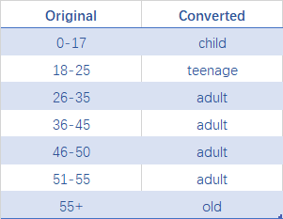
Data Field Normalization
When age fields are used for analysis or model training, using descriptive labels rather than discrete numeric ranges can provide more meaningful results.
We plan to use a mapping table to convert the age values.

Slide 13
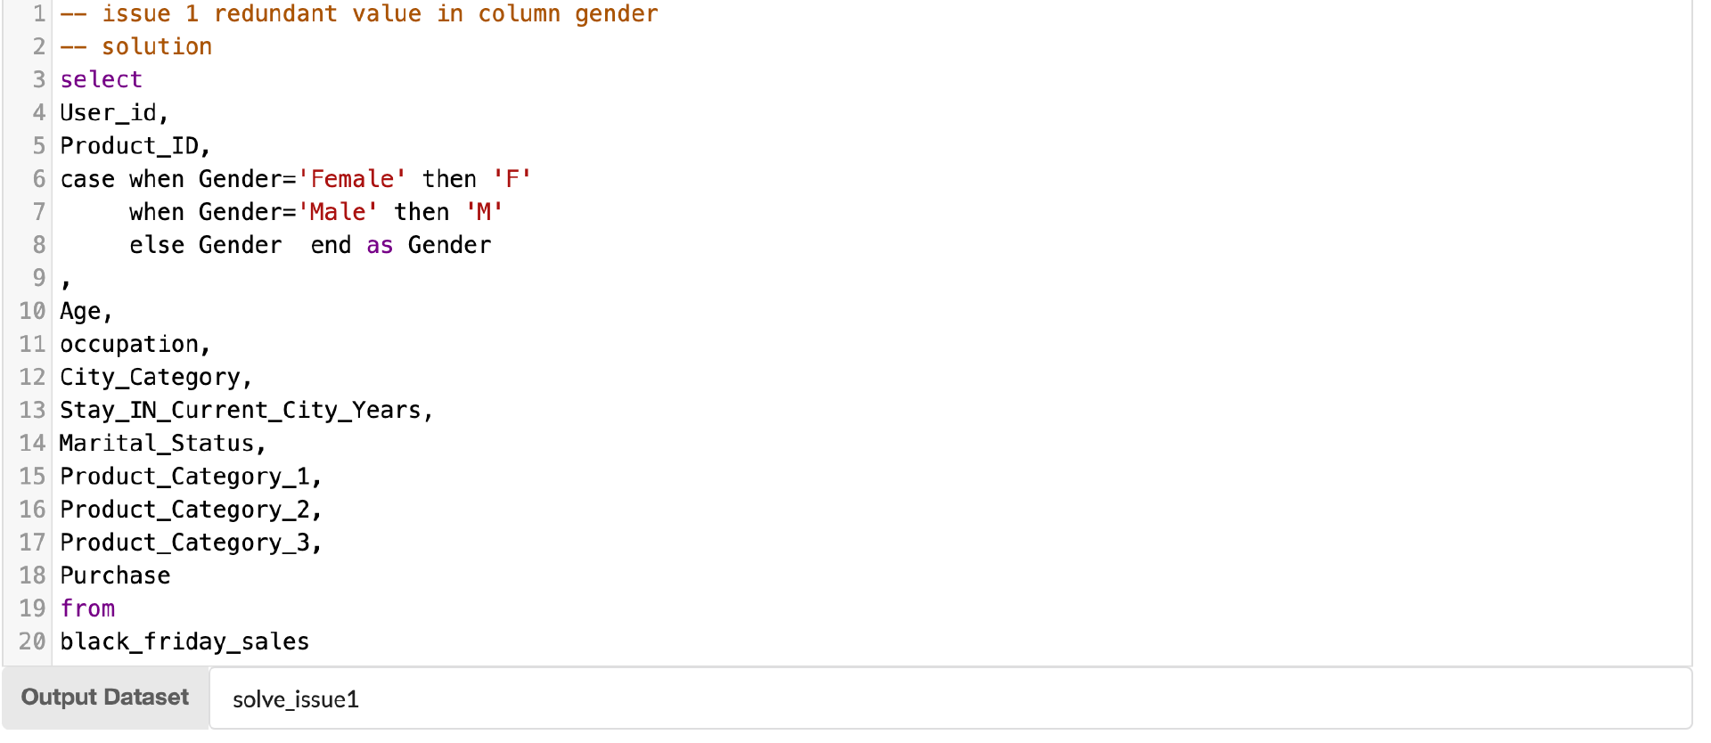
Solution for Data Inconsistency
This issue involve 192182 lines, about 34.93% of the dataset
To solve it, we decide to use replacement to union the values in column gender, details refer to SQL Female to F Male to M

Slide 14
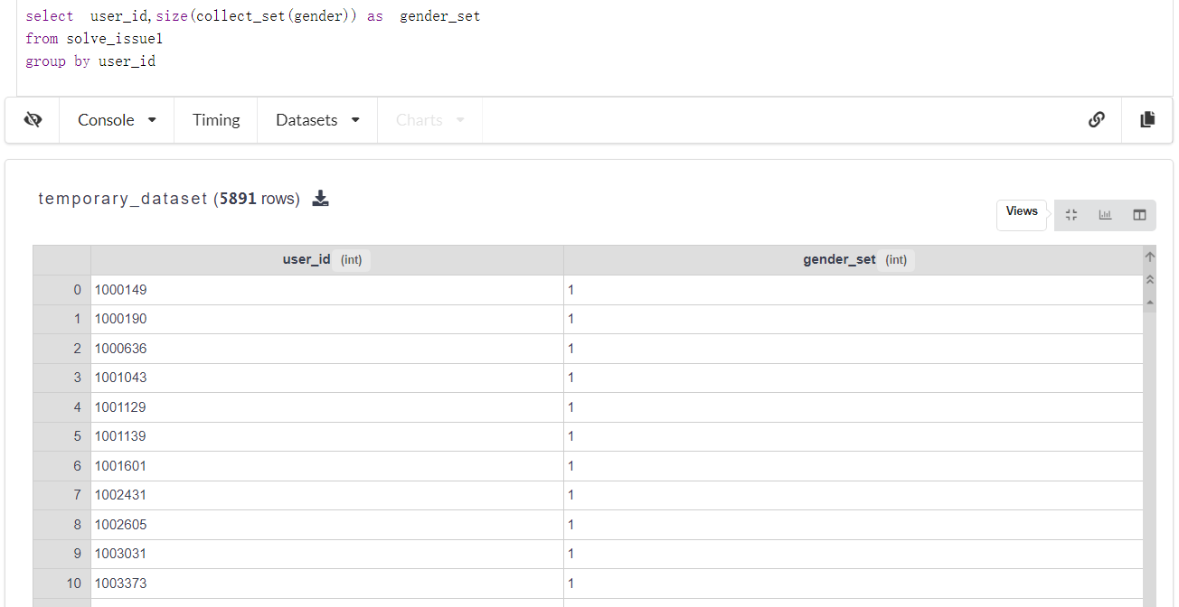
Solution for Inconsistent Representations
Total 84726 incorrect values found, about 15.4% of the dataset
Solution: to clear the different gender value for one user, we should try to use the same word to display gender. And when we fixed issue 1 above by replacing "Female" with "F" and "Male" with "M", we find this issue also be resolved. Check the result dataset of issue 1, we get the below result, which one user only have one gender representation.

Slide 15
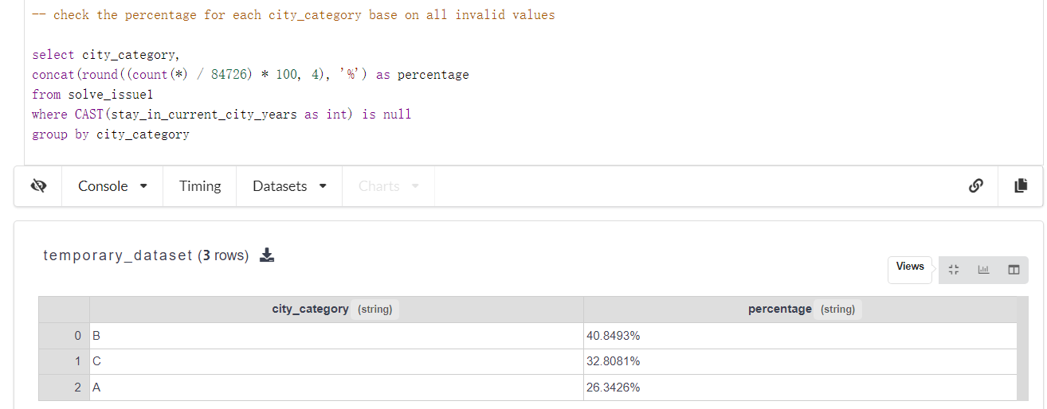
Solution for Incorrect values
Stay_In_Current_City_Years
This issue involves 84726 lines, about 15.4% of the dataset.
By checking the percentage for each City_Category based on the invalid values in Stay_In_City_Years, we find when City_Category is ‘B’, it might have a bigger probabiltiy to stay in currenty city for longer time.

Slide 16
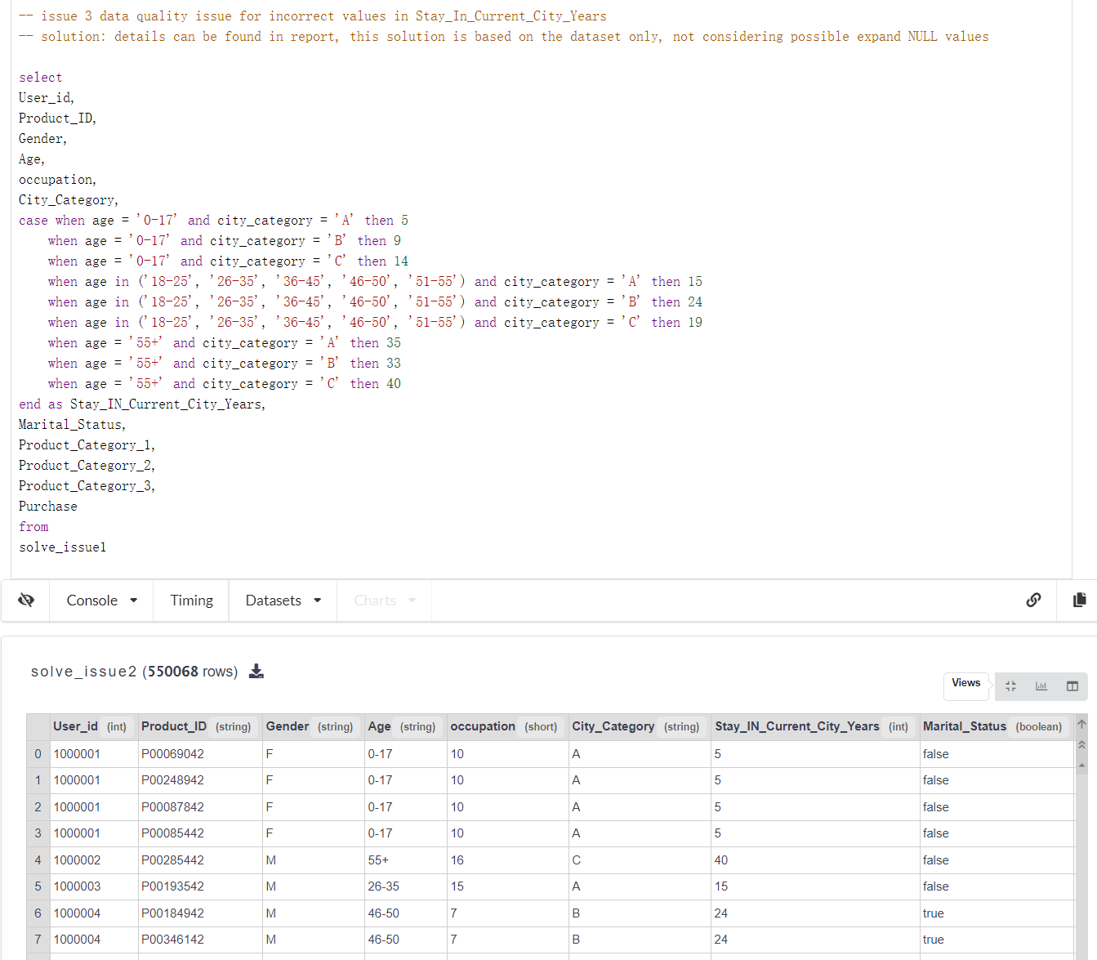
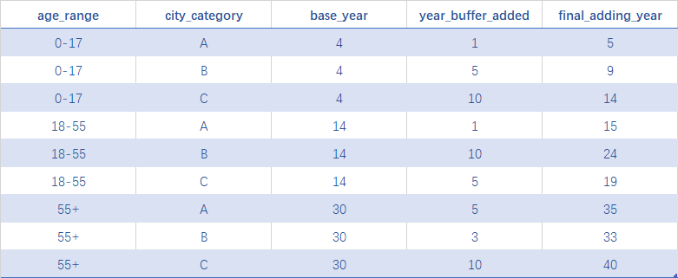
Solution for Incorrect values
The solution we decide to base on below table, setting the value in final_adding_year to the Stay_In_Current_City_Years of condition in age_range and city_category.

Slide 17
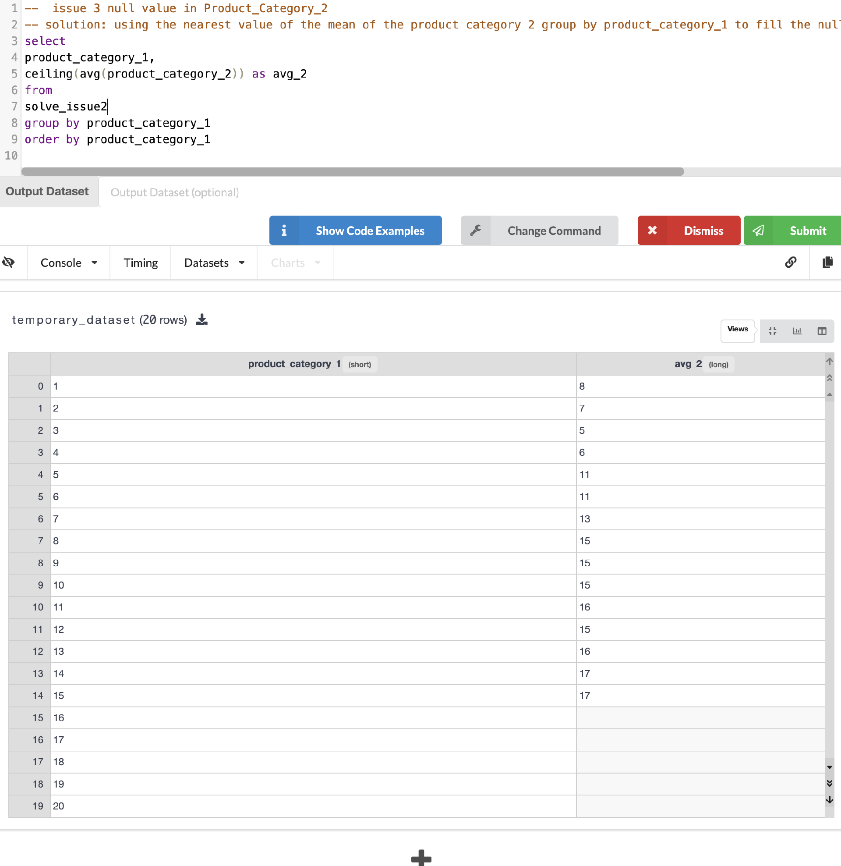
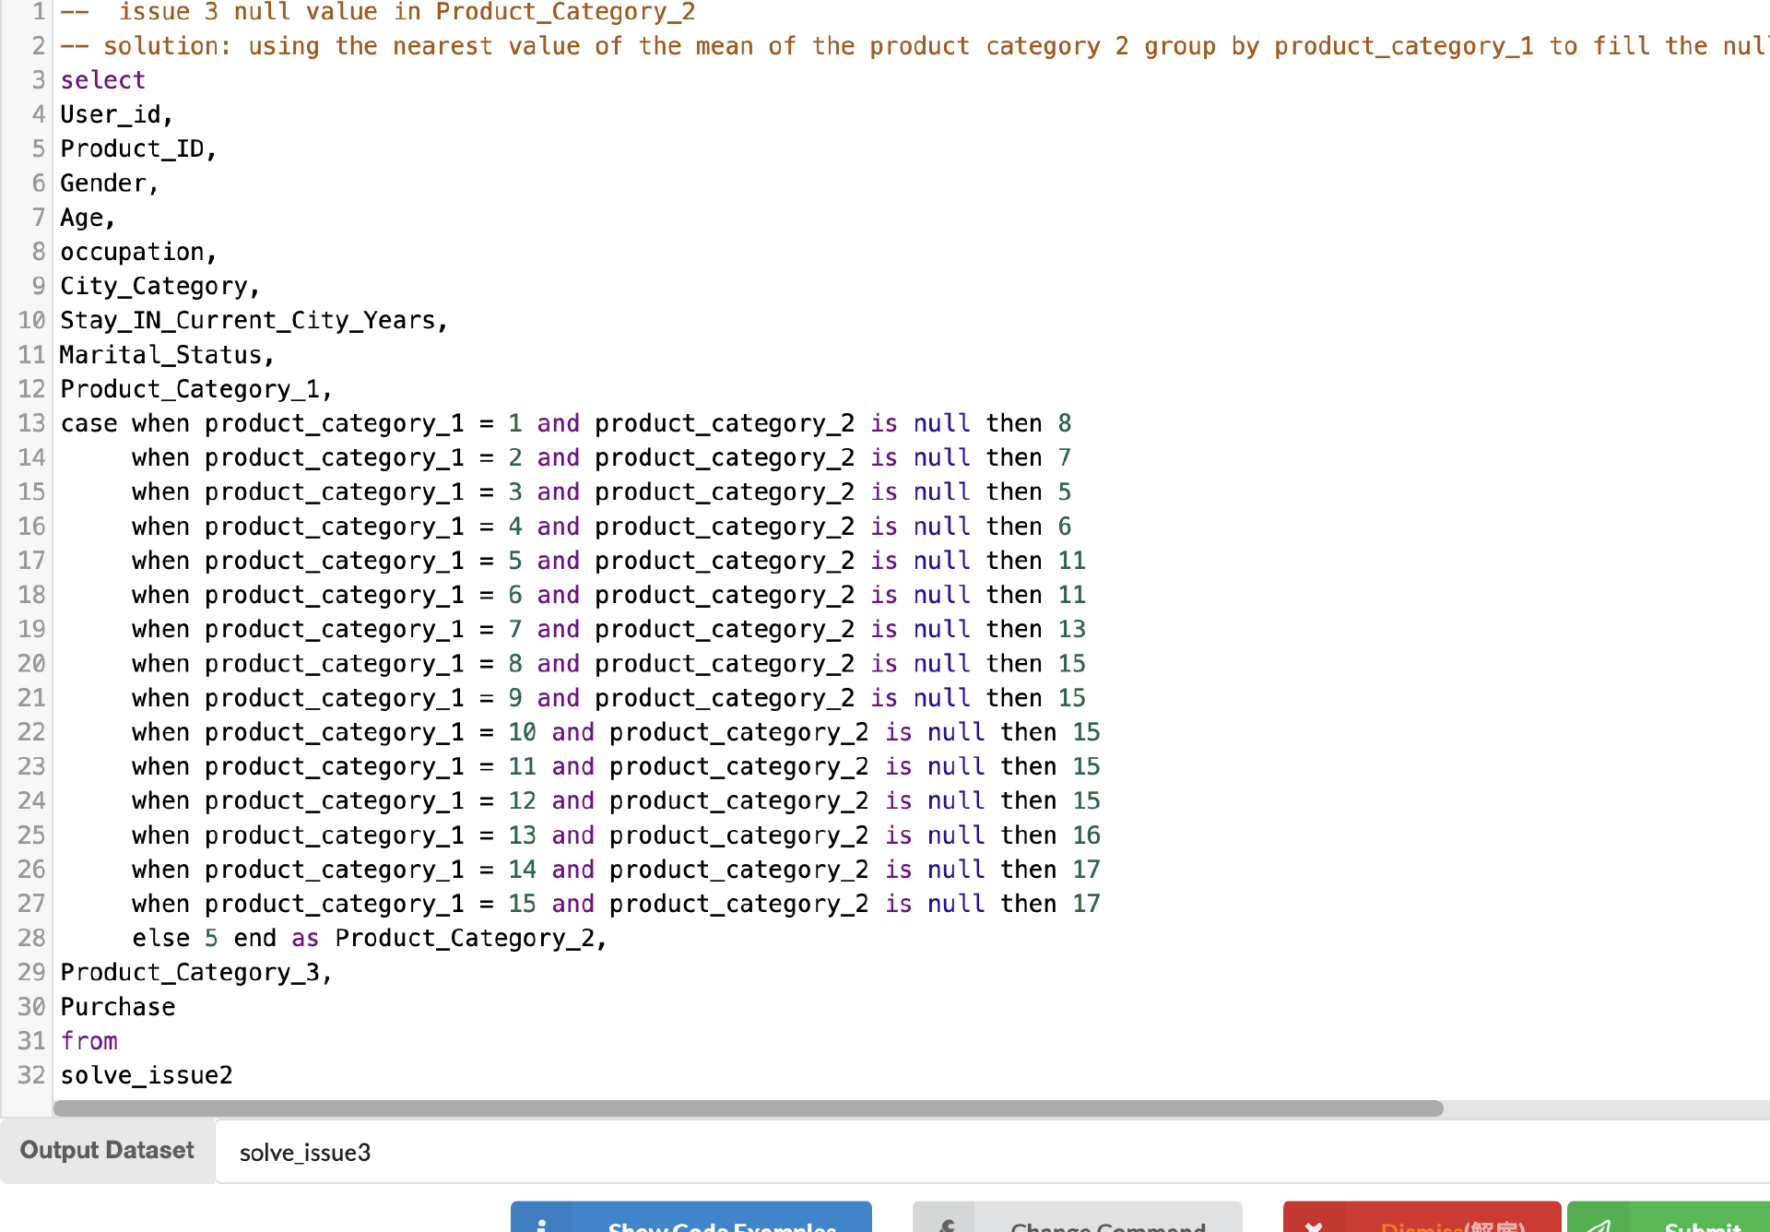
Solution for Null Values
This issue involves 2 columns:
Product_Category_2: 173,638 NULL values total, about 31.57% of the dataset.
Product_Category_3: 383,247 NULL values total, about 69.67% of the dateset.
Solution：
For Product_Category_2: using the nearest value of the mean of the product category 2 group by product_category_1 to fill the null value of product_category_2.
For Product_Category_3：there are almost 70% percent missing, and no good dependency function can be found, we decide to drop this column.

Slide 18
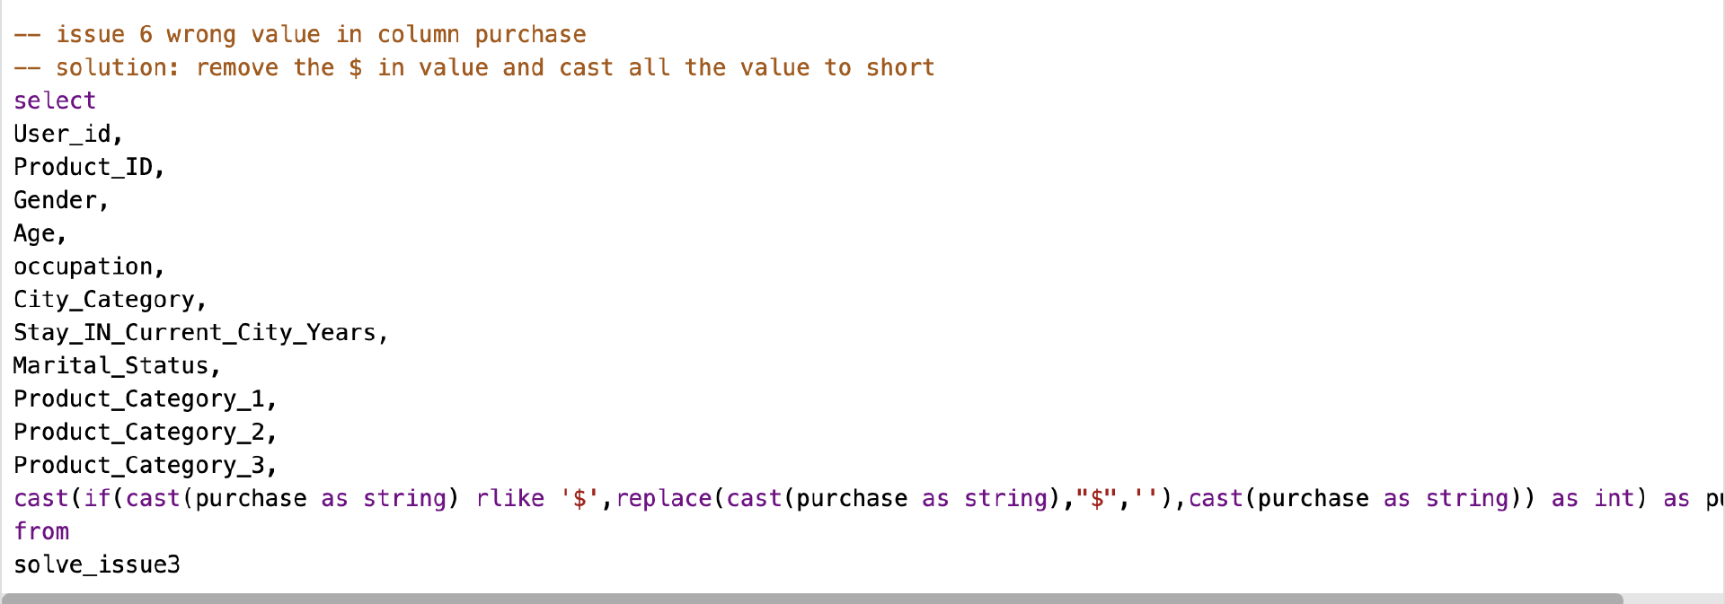
Solution for Incorrect Values - Purchase
Some value with $, affected 28,026 lines, 5.9% of the dataset.
Solution: we think the number for the incorrect lines is correct, we just need to remove the "$" symbol and cast the values to short.

Slide 19
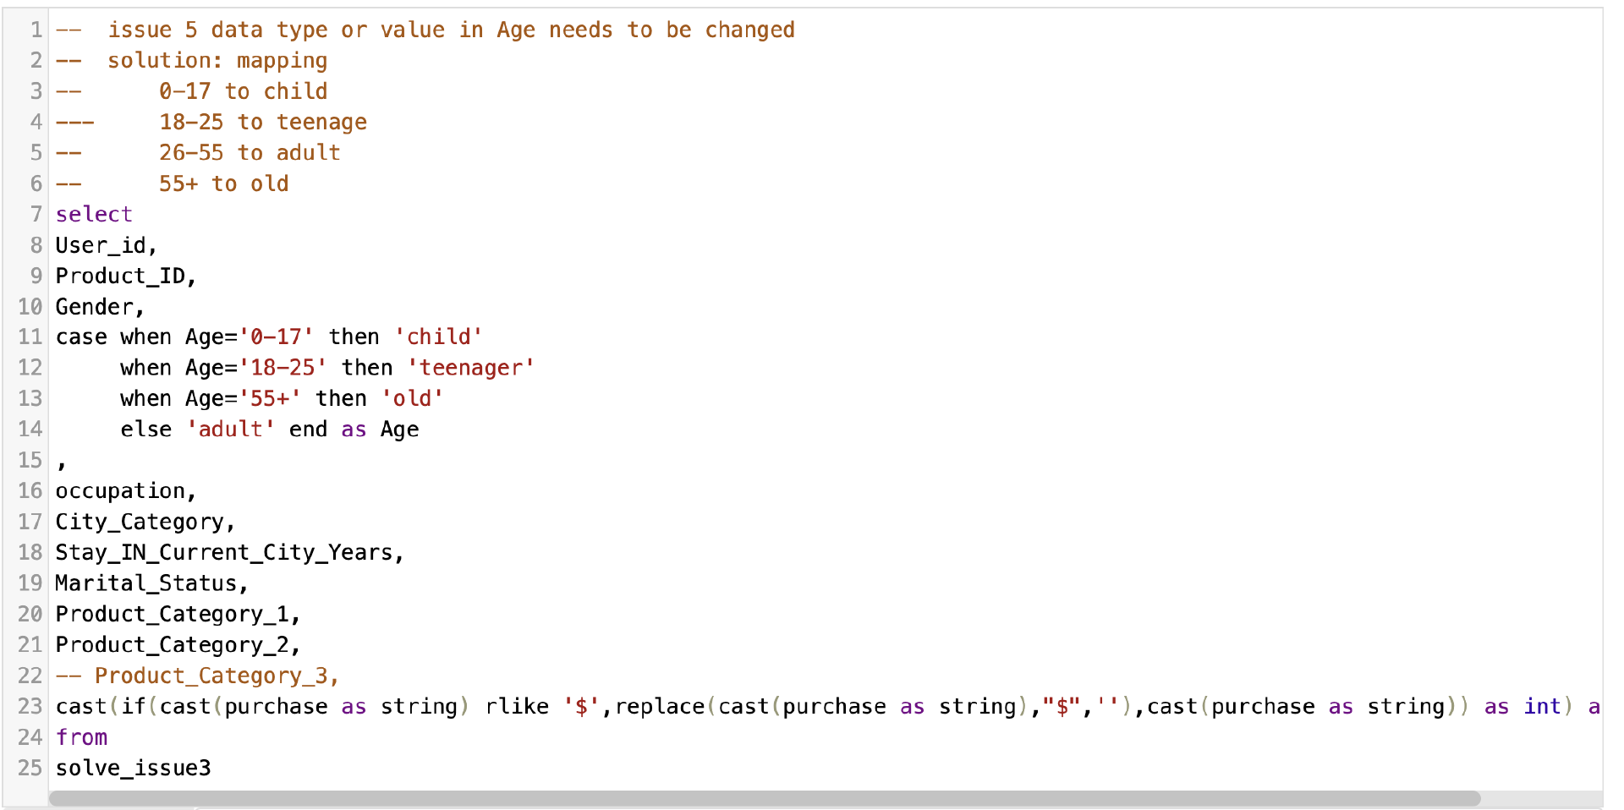
Solution for data field normalization
Solution: use the mapping table we introduced in last section, we update the dataset

Slide 20
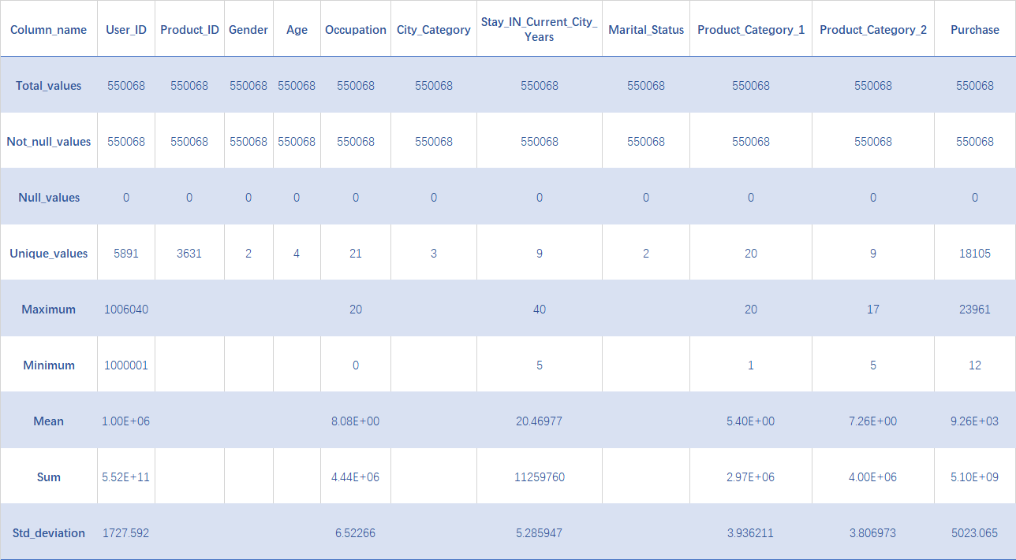
Validation
Check the overview of the updated dataset, the NULL values not exist any more, and Product_Category_3 column has been removed. Let's check the result of other 5 issues.

Slide 21
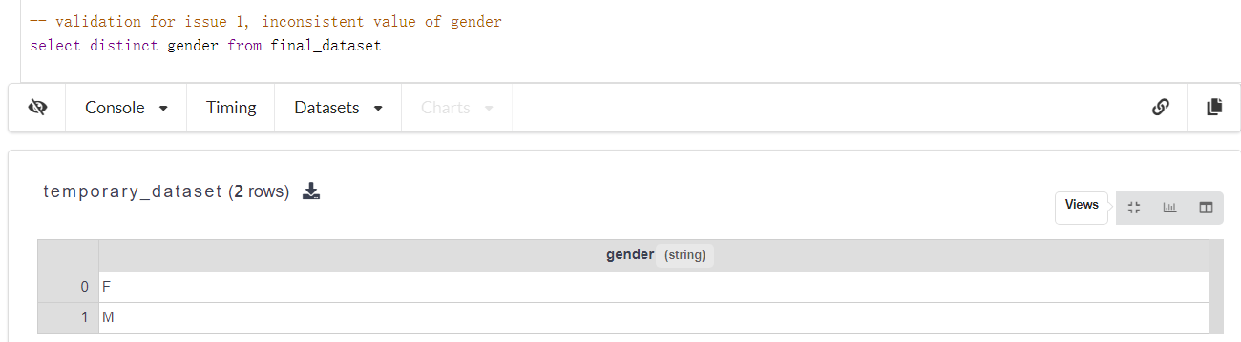
Validation
Data Inconsistency
We solved the data inconsistency in the Gender column by using the mapping relationship as Female -> F, Male -> M.

Slide 22
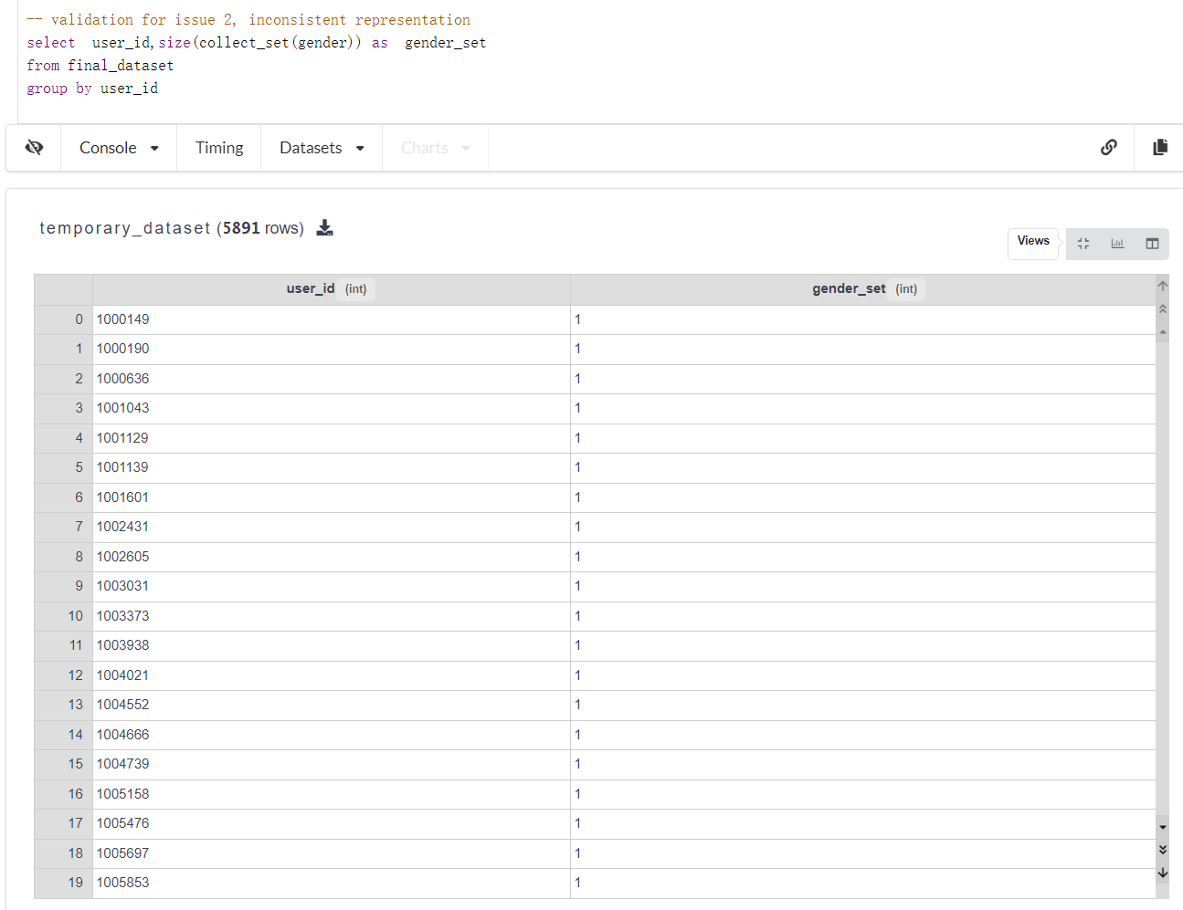
Validation
Inconsistent representations
The result shows that there is one gender for one user.

Slide 23
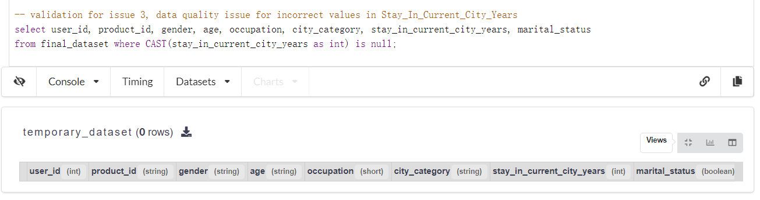
Validation
Data quality issue for incorrect values - Stay_In_Current_City_Years
No more incorrect values with '+' as string in Stay_In_Current_City_Years

Slide 24
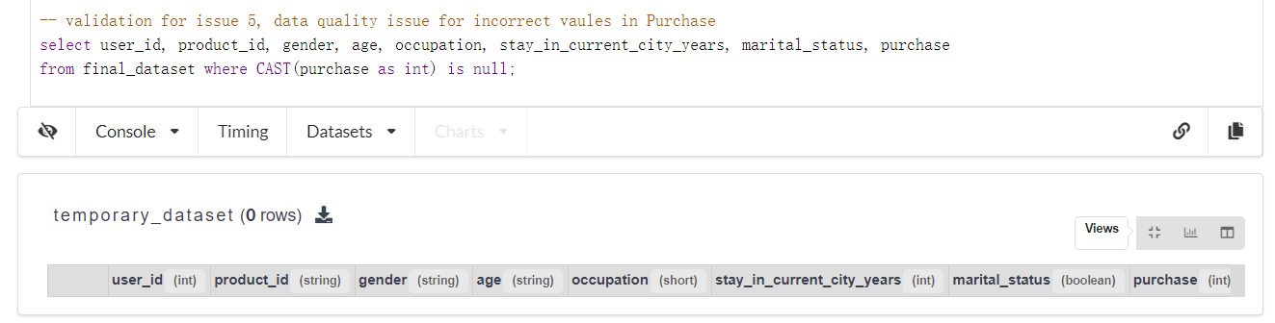
Validation
Data quality issue for incorrect values – Purchase
No more incorrect values with '$' as string in Purchase

Slide 25
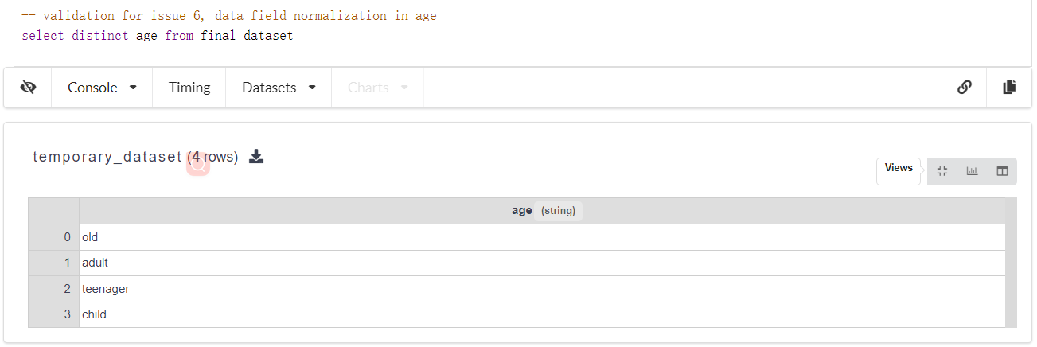
Validation
Data field normalization
The values in age column are no more age range, now use descriptive labels

Slide 26
Summary
Initial Issues: Data inconsistencies, erroneous entries, and missing values.
Curation Techniques:
Mapping for uniform data representation.
Replacing incorrect values.
Filling in missing data for completeness.
Result: A cleansed dataset ready for machine learning modeling.
Impact: Provides a solid foundation for accurate analysis and predictive modeling of Black Friday sales trends.

Slide 27
Thank you very much for watching !

